Slide 1
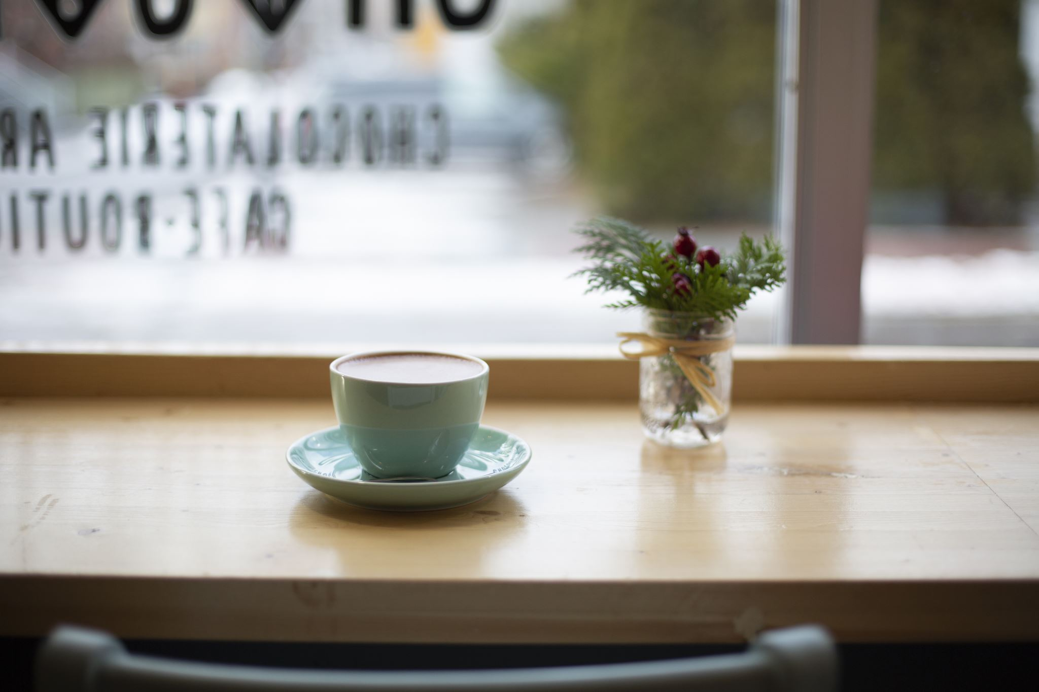
BRIGHLEARN COFFEE SHOP

Slide 2
Brightlearn coffee shop
Astoria
Astoria
OPERATING HOURS:
Monday to Sunday 9am to 9pm
Store locations:
Astoria
Lower Manhattan
Hell`s Kitchen

Slide 3
Brightlearn coffee shop products
Coffee
Tea
Bakery
Drinking Chocolate
Flavours

Slide 4
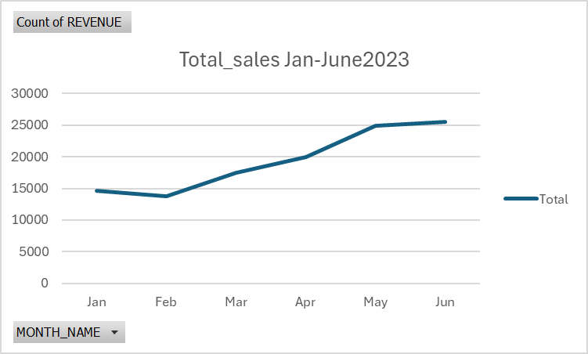
Total_ sales jan-June 2023

Slide 5
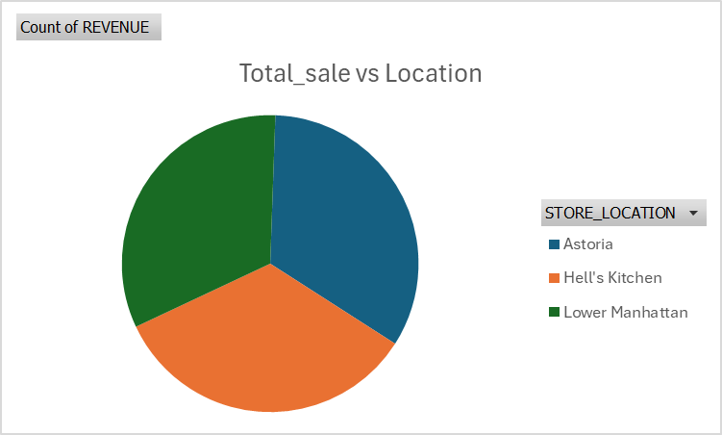
Total sales vs location

Slide 6
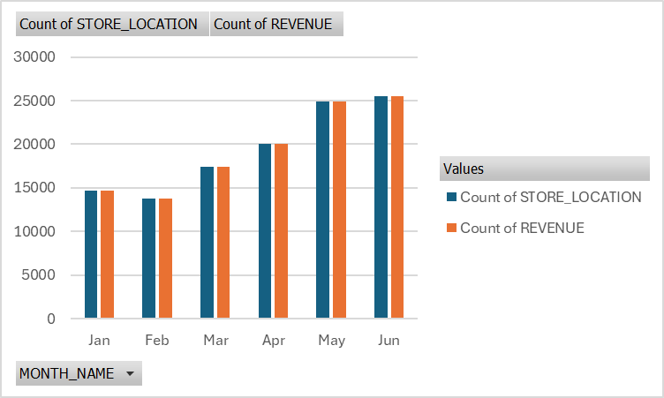
Total sales vs month and location

Slide 7
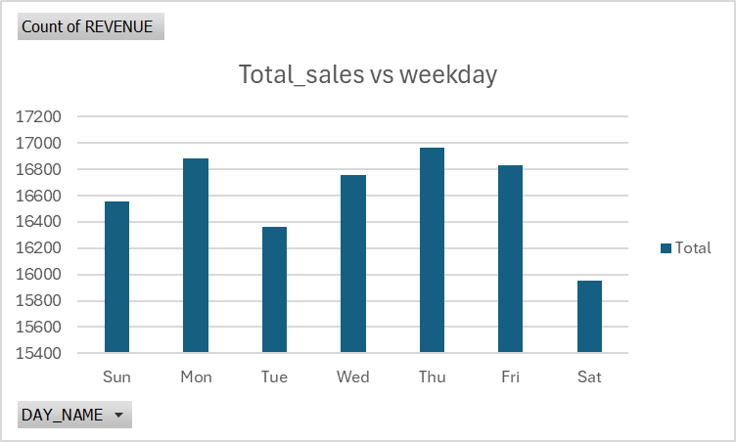
Total sales vs weekday

Slide 8
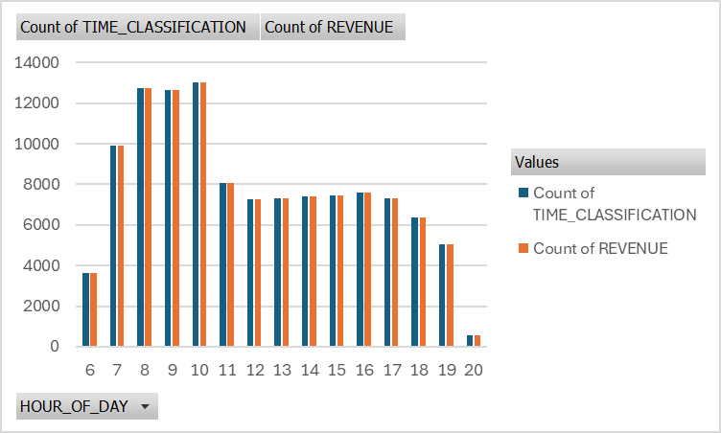
Total sales vs time buckets

Slide 9
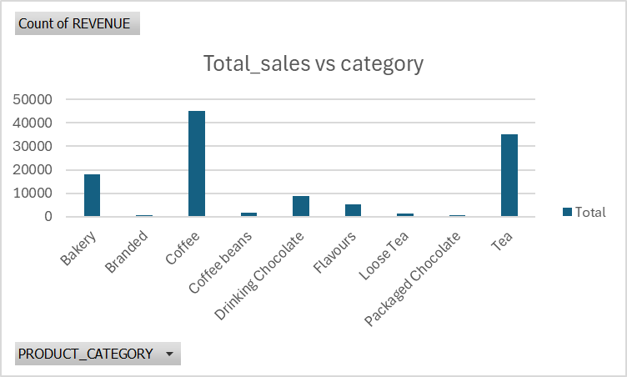
Total sales vs category

